Slide 1
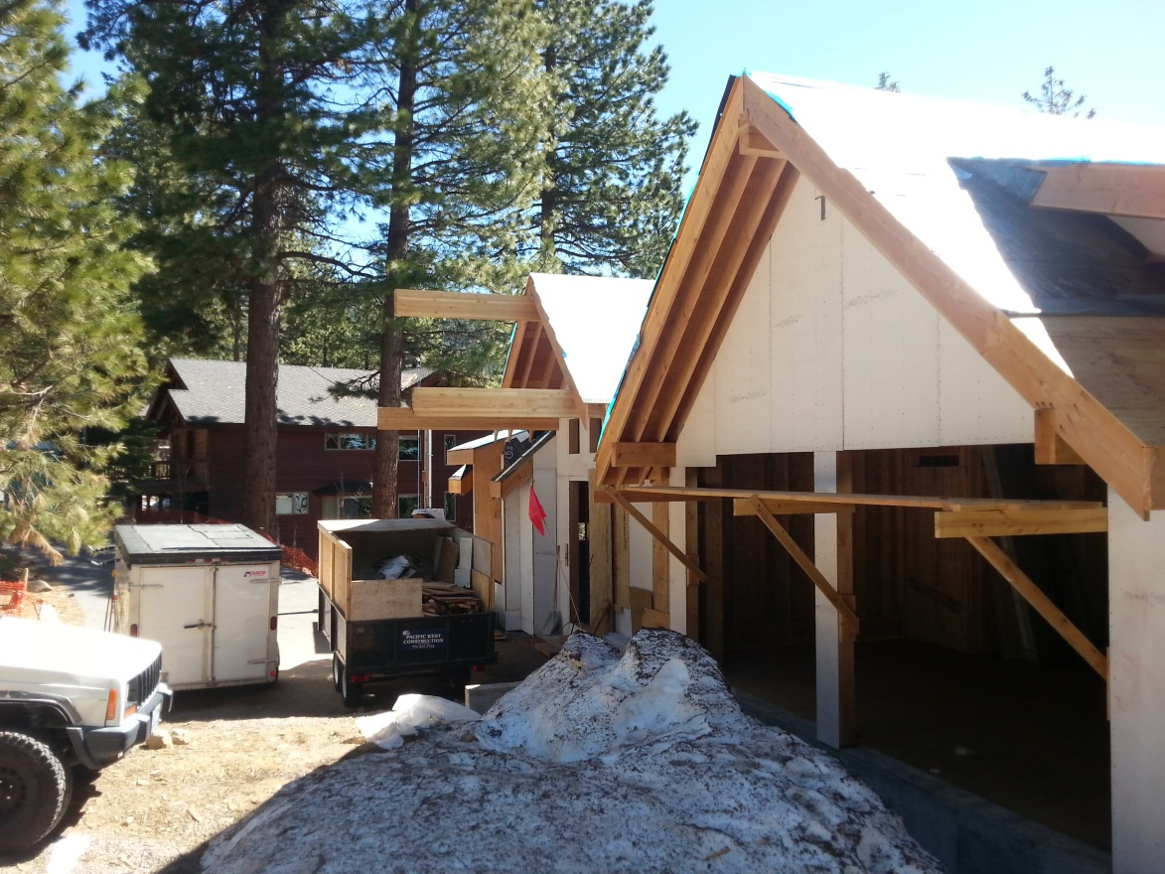
Washoe County Board of Adjustment
June 1, 2017
Variance Case Number WVAR17-0002
(Fisher / Kintz Front Yard Setback Reduction)

Slide 2
Case Description
For possible action, hearing, and discussion to approve a variance to reduce the required front yard setback from 20 feet to 10 feet 2 inches for expansion of a dwelling that is currently permitted and under construction (the total encroachment, including the overhang, is proposed to be 9 feet 10 inches). The proposed encroachment into the front yard setback includes a cover for the front porch with a depth of 7 feet 10 inches and an additional 2 feet of roof eave overhang within the front yard setback. The variance request also includes a reduction in the front yard setback from 20 feet to 19 feet 6 inches for a “decorative truss” at the front of the garage.

Slide 3
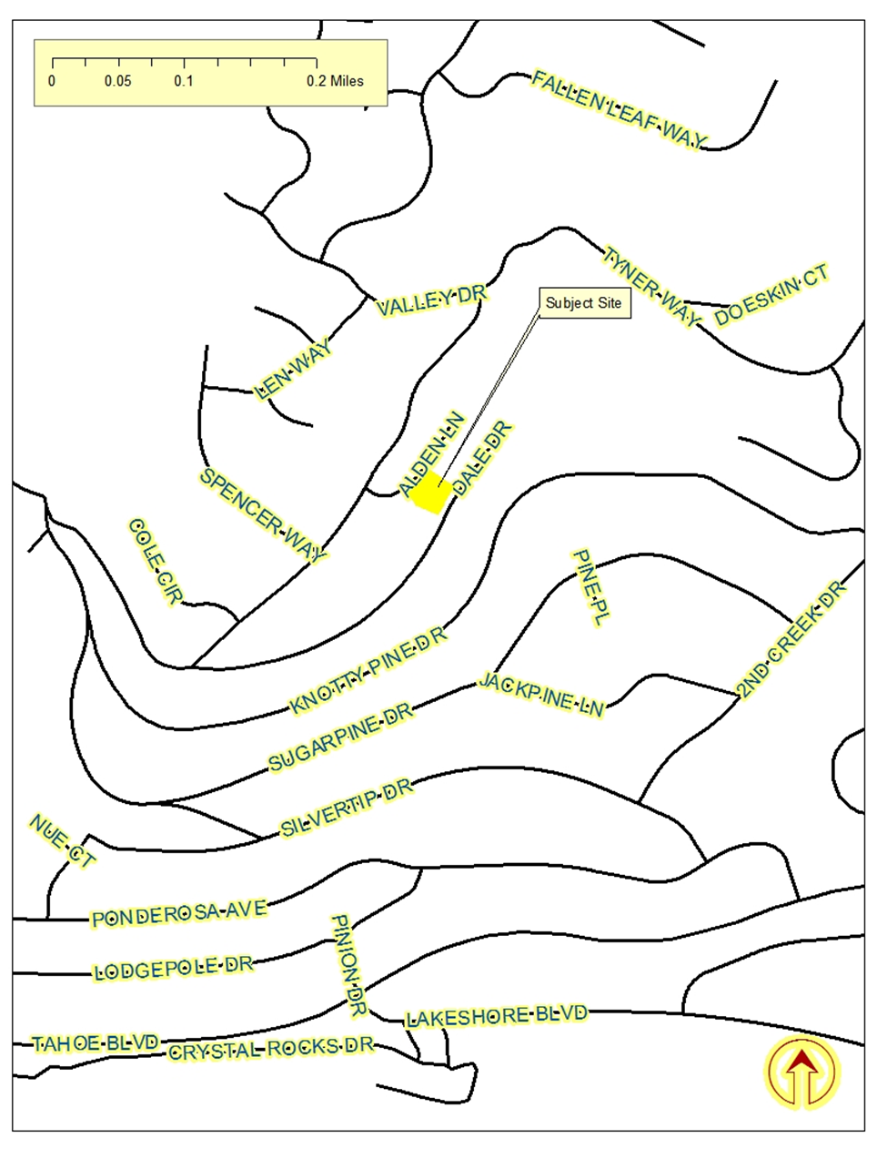
Vicinity Map

Slide 4
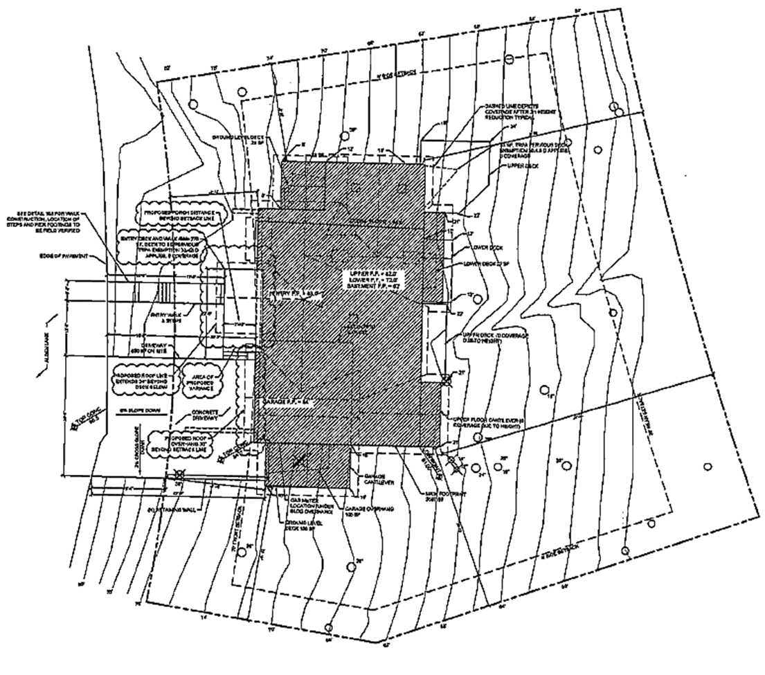
Site Plan

Slide 5
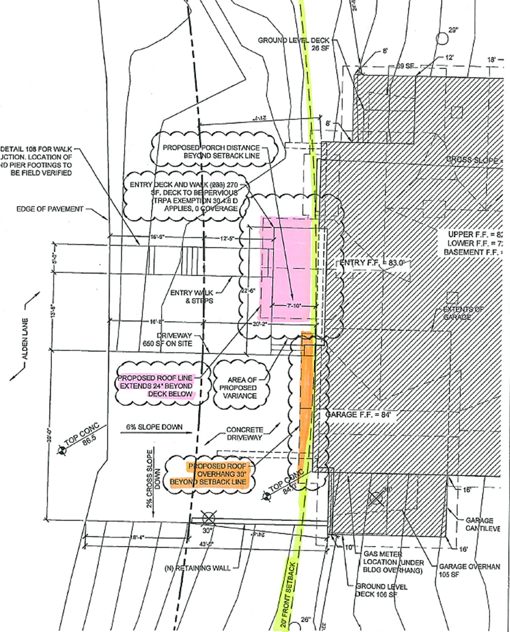
Site Plan Detail

Slide 6
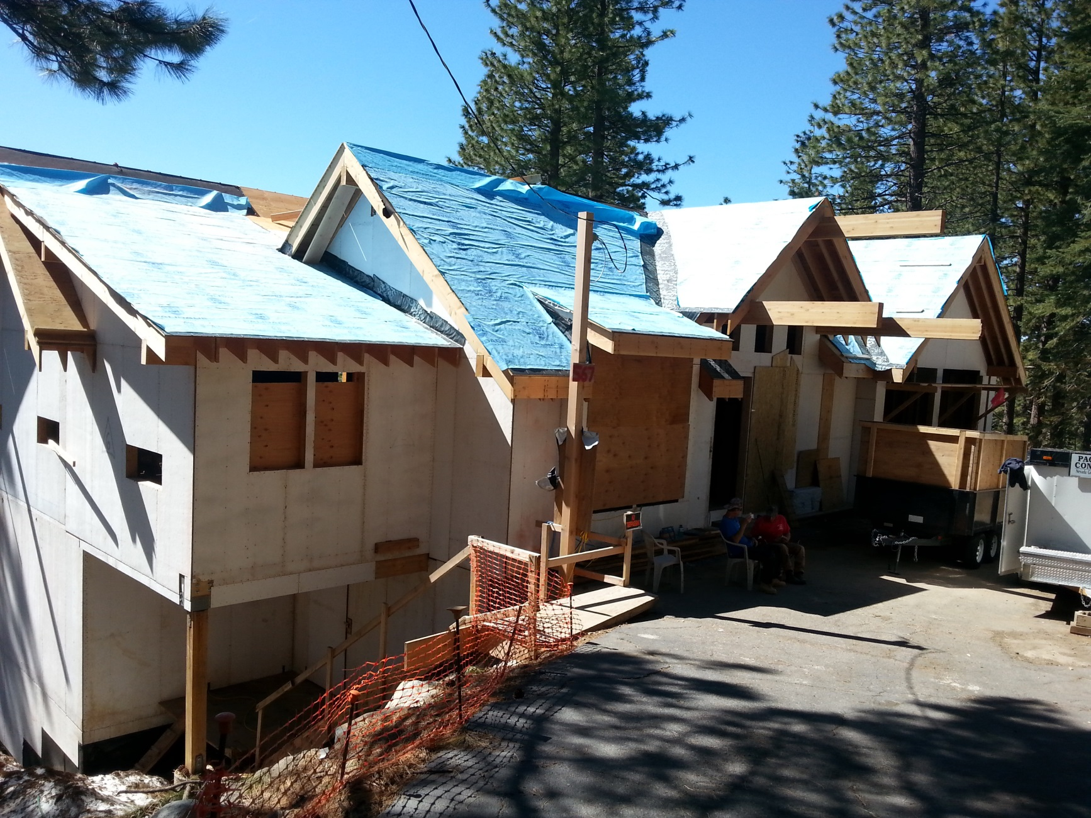
Current Photo of Subject Site

Slide 7
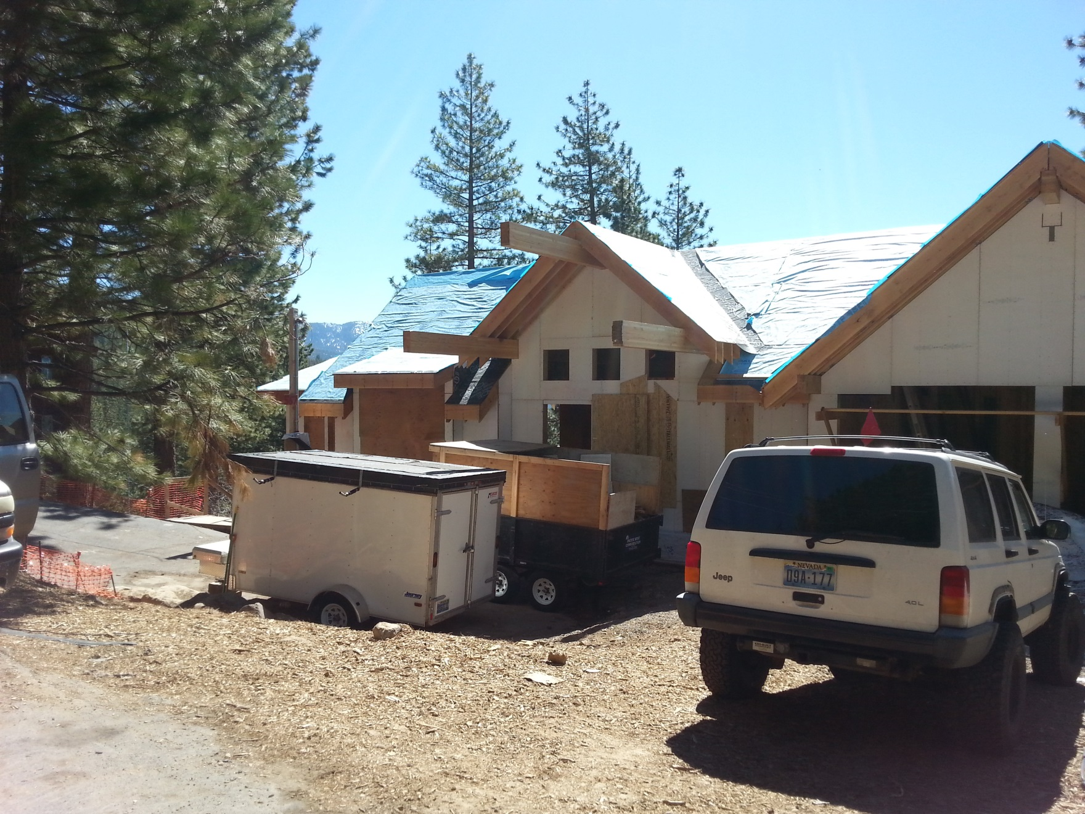
Current Photo of Subject Site

Slide 8
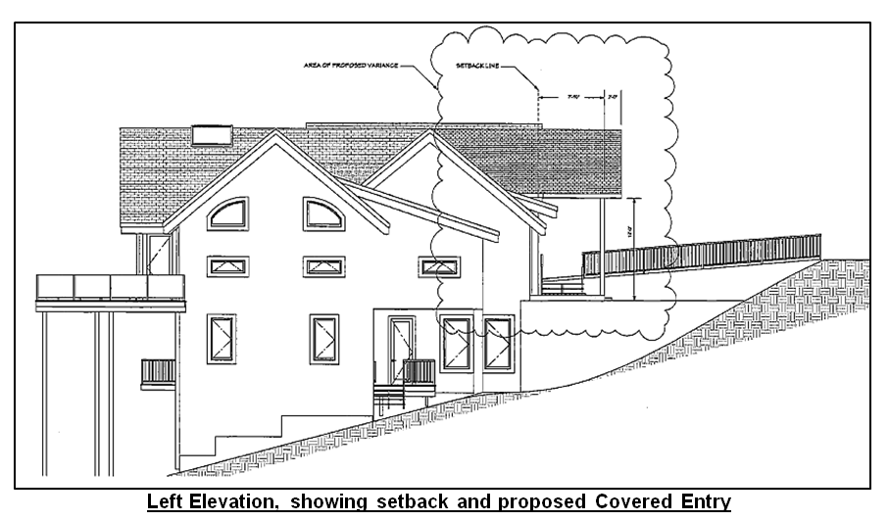
Background

Slide 9
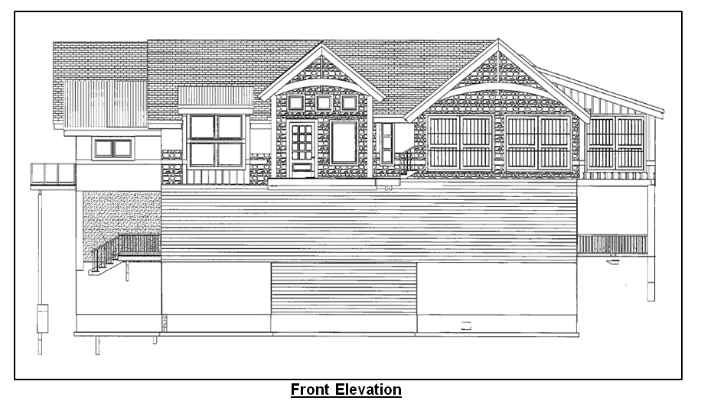
Background

Slide 10
Background
Nevada Revised Statues limits the power of the Board of Adjustment to grant variances only under particular circumstances. Among those circumstances are: 1) exceptional narrowness, shallowness, or shape of a specific piece of property; or 2) by reason of exceptional topographic conditions; or 3) other extraordinary and exceptional situation or condition of the piece of property. If such a finding of fact can first be made, then the Board must also show that the strict application of the regulation would result in peculiar and exceptional practical difficulties to, or exceptional and undue hardships upon, the owner of the property.

Slide 11
Background
A 3-story, 4-bedroom, 3-bath dwelling of 4,795 square feet, with a 3-car garage, is currently under construction on the subject parcel. The plans approved for that dwelling show compliance with all required yard setbacks.

Slide 12
Analysis
Exceptional Narrowness: The parcel is located within the Medium Density Suburban (MDS) regulatory zone. The minimum lot size required in that zone is 12,000 square feet. The subject parcel is approximately 16,988 square feet in size. The minimum lot width in that zone is 80 feet. The subject parcel is approximately 140 feet in width at the midpoint of the property.
The subject parcel is not exceptionally narrow.

Slide 13
Analysis
Exceptional Shallowness: The depth of the property from Alden Lane to the Dale Drive is approximately 120 feet.
The subject parcel is not exceptionally shallow.

Slide 14
Analysis
Exceptional Topographic Conditions: The subject parcel is sloped at approximately about 31%. Sloped lots are common in the Tahoe Area Plan, and by themselves are not exceptional. There were no constraints prohibiting the applicant from designing a covered entry way within the required setbacks.
The topography of the subject parcel is not exceptional.

Slide 15
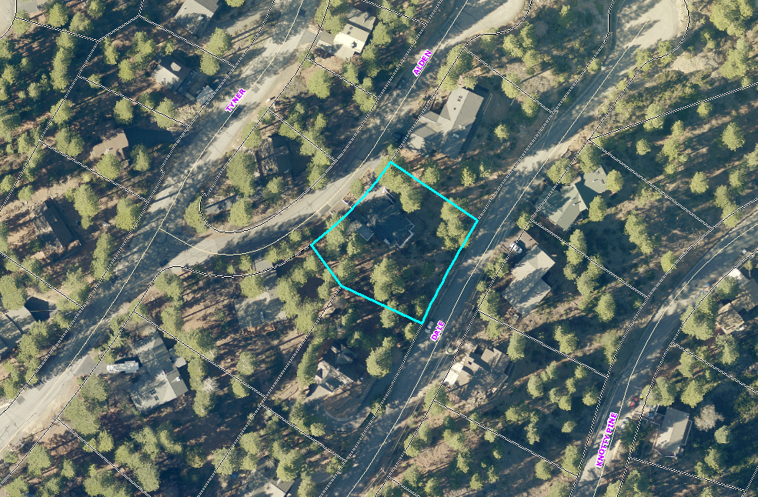
Analysis

Slide 16
Variance
Other Extraordinary and Exceptional Situation or Condition of the Piece of Property:
The applicant, “…tried many different design ideas none of which made practical or aesthetic sense given the height and other TRPA restrictions we had to comply with.”
TRPA Height restrictions are consistent throughout the Tahoe Basin and are, therefore neither extraordinary or exceptional.
“Aesthetic sense” is not a condition of the parcel of land and, therefore, does not create an Extraordinary and Exceptional Situation or Condition.
The “practicality” of the plan requiring a variance is called into question when one considers that the applicant has approved construction plans for a dwelling on the parcel, that conforms with all required setbacks.
There is no extraordinary and exceptional situation or condition on this piece of property.

Slide 17
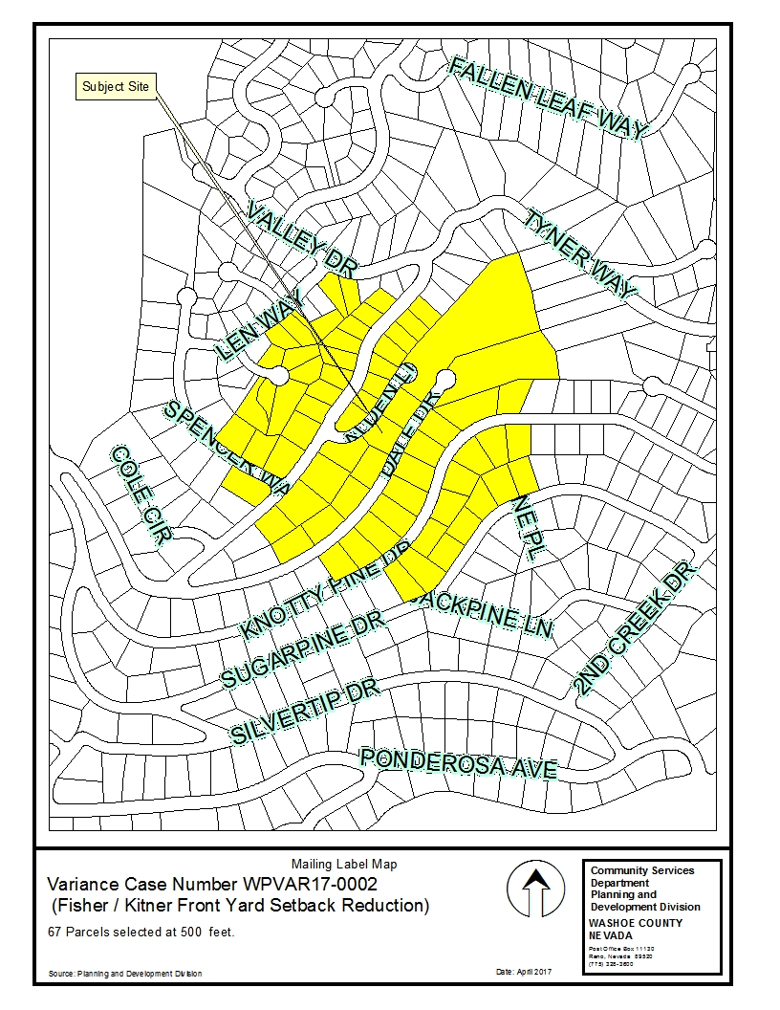
Public
Notice

Slide 18
Conditions of Approval
Are not included with this report as denial is recommended.

Slide 19
Variance Findings

Slide 20
Variance Findings (continued)

Slide 21
Variance Findings (continued)

Slide 22
Variance Findings (continued)

Slide 23
Variance Findings (continued)

Slide 24
Recommendation
Staff has been unable to identify any special circumstances applicable to the piece of property that would allow support of approval of the variance request. Therefore, after a thorough analysis and review, Variance Case Number WPVAR17-0002 is being recommended for denial.

Slide 25
Possible Motion
I move that, after giving reasoned consideration to the information contained in the staff report and information received during the public hearing, the Washoe County Board of Adjustment deny Variance Case Number WPVAR17-0002 for Michael Fisher and Susanna Kintz, being unable to make findings 1, 2 and 3 in accordance with Washoe County Development Code Section 110.804.25.

Slide 26
Questions?

